Slide 1



Sponsors

Slide 2
Introduction To Ethical Hacking
By Brandon S. Keath
Sr. Security Engineer

Slide 3

Who Is This Brandon Guy Anyway?
Sr. Security Engineer at D&H Distributing
Soon to be Cyber Security Architect for Appalachia Technologies
Master’s of Cyber Security and Information Assurance(in three weeks) from Western Governor’s University
EC-Council Certified Ethical Hack & Certified Hacking Forensics Investigator
I like to Program in Python and Hack stuff!

Slide 4
Agenda
What is a Hacker?
What makes a hacker ethical
Mindset of a hacker?
Hacker Methodology
Reconnaissance
Scanning
Gaining Access
Maintaining Access
Covering Tracks
Web Hacking
OWASP Top 10
OWASP Testing Guide
Burp Suite OWASP ZAP
Web Goat, BWAPP, Juice Shop
Bug Bounty Hunter
Who Do Hackers Target?
Defense in Depth
Types of Cyber Security Professionals

Slide 5

What is a Hacker?
Modern Version of Hacker:
a person who uses computers to gain unauthorized access to data.
synonyms: cybercriminal, pirate, computer criminal, keylogger, keystroke logger;
Original Meaning:
Is any skilled computer expert that uses their technical knowledge to overcome a problem.

Slide 6

What is an Ethical Hacker?
A hacker who gains permission before attempting
To hack into a computer system, network, or device.

Slide 7


Mind Set of Hacker

Slide 8
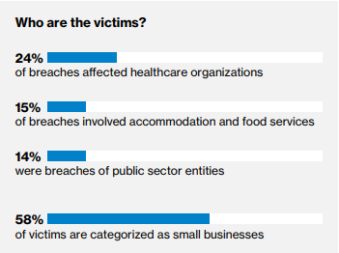
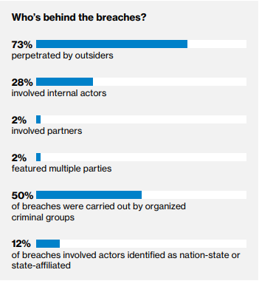
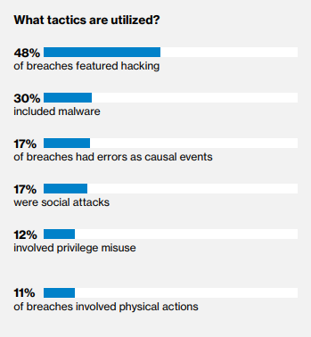
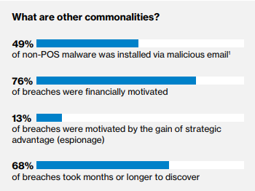
What do Hackers Target

Slide 9
Types of Cyber Security Professionals
Red
Team
Ethical Hacking
Network and Web Pen Testing
Blue
Team
Defense management
Antivirus, Encryption, Firewalls, SIEM, ETC
Purple
Team
Mix of red and blue team
Sometimes considered management or compliance related role.

Slide 10
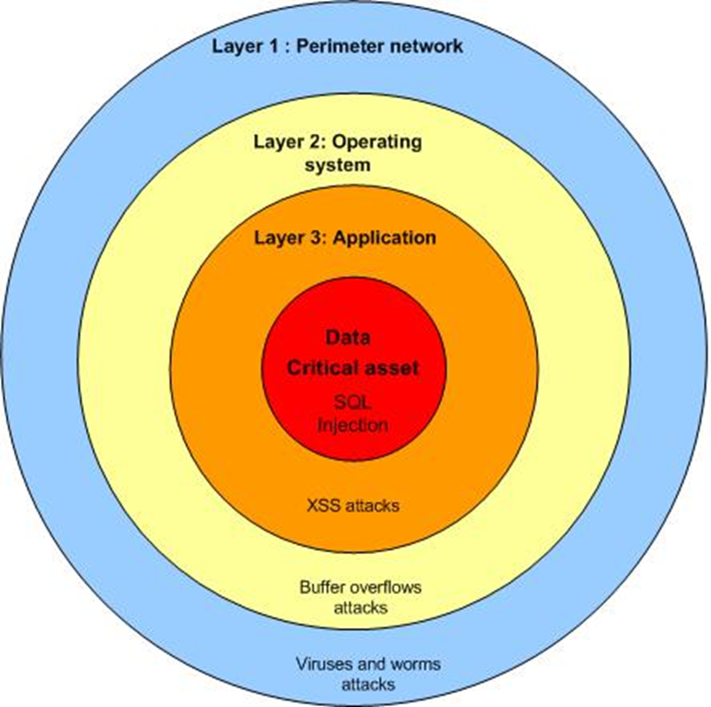

Defense In Depth

Slide 11


Reconnaissance

Slide 12
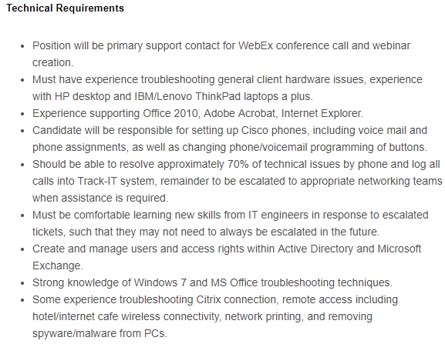
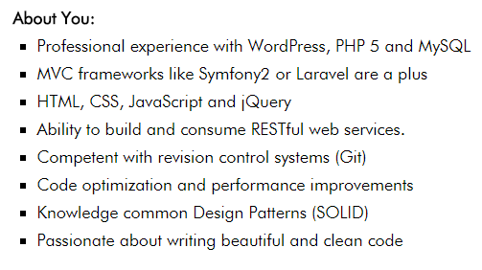
Look at Job Ad’s

Slide 13

Dumpster Diving

Slide 14
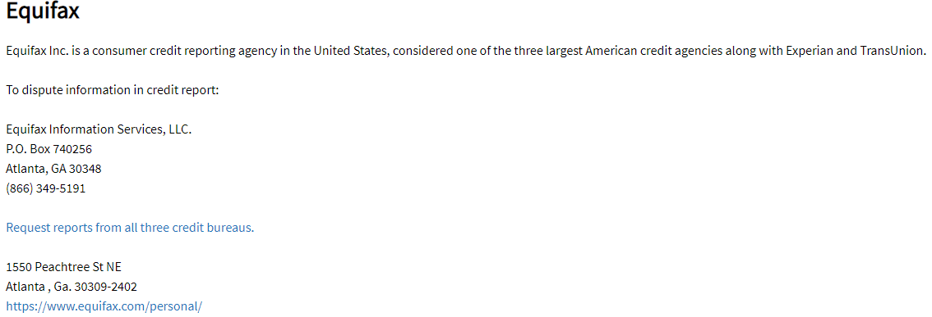
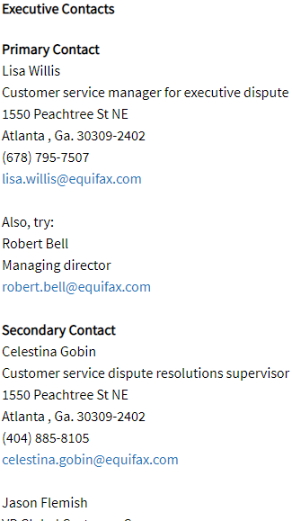
Look at Company contacts on Elliott Advocacy

Slide 15
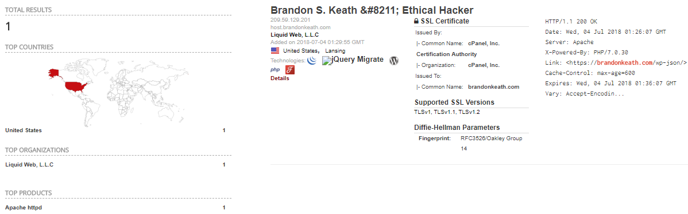
Shodan.io

Slide 16
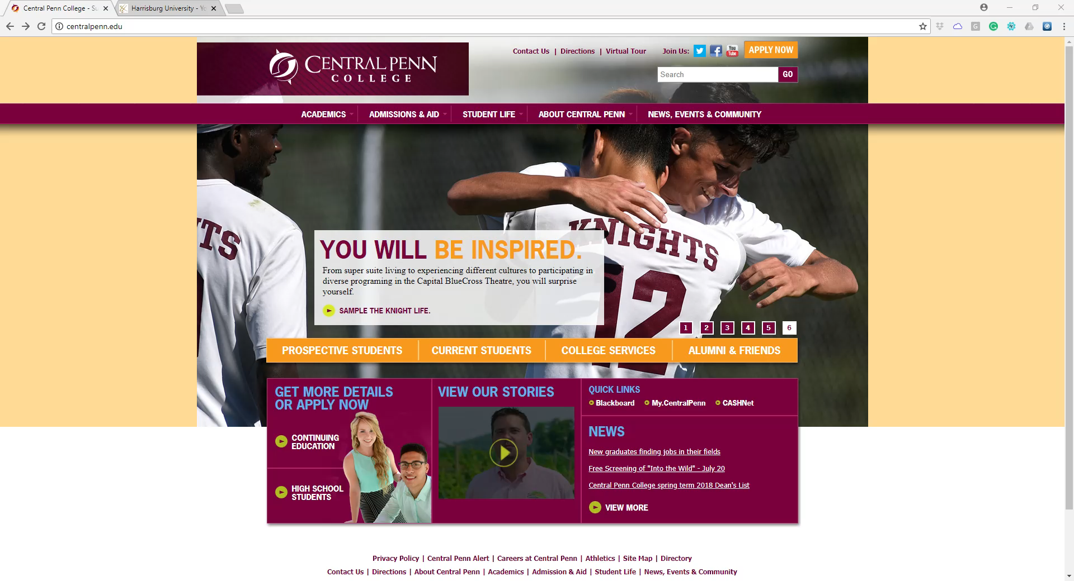
Recon Demo #1

Slide 17
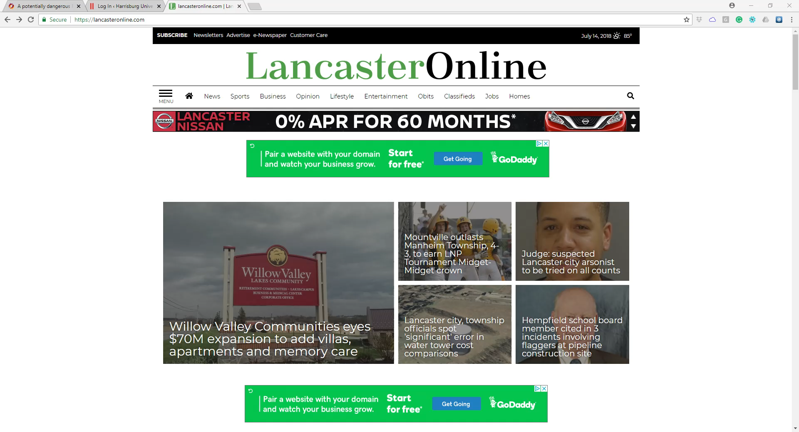
Recon Demo #2

Slide 18

Review What is Reconnaissance

Slide 19


Scanning

Slide 20
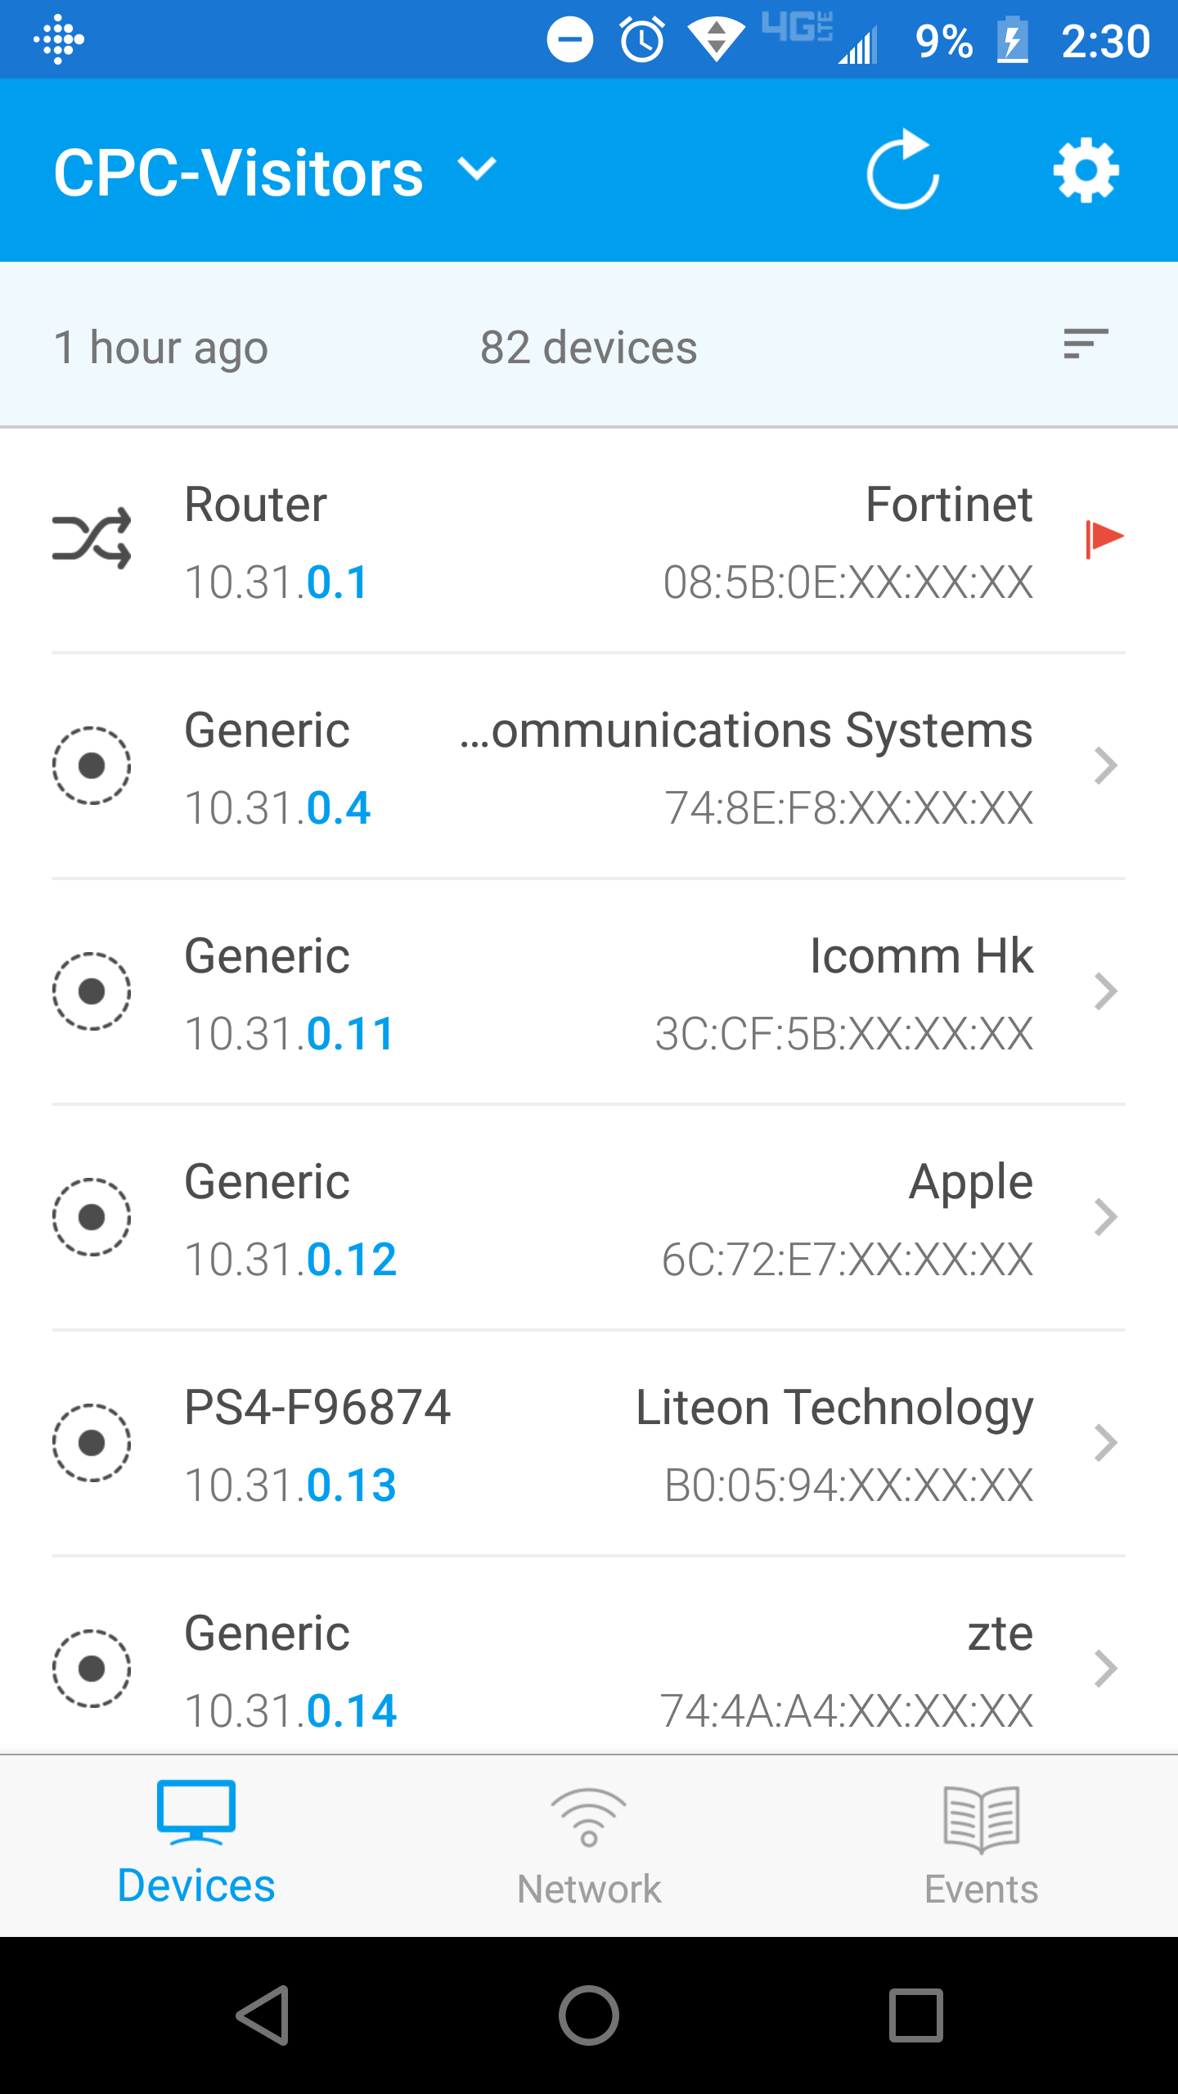
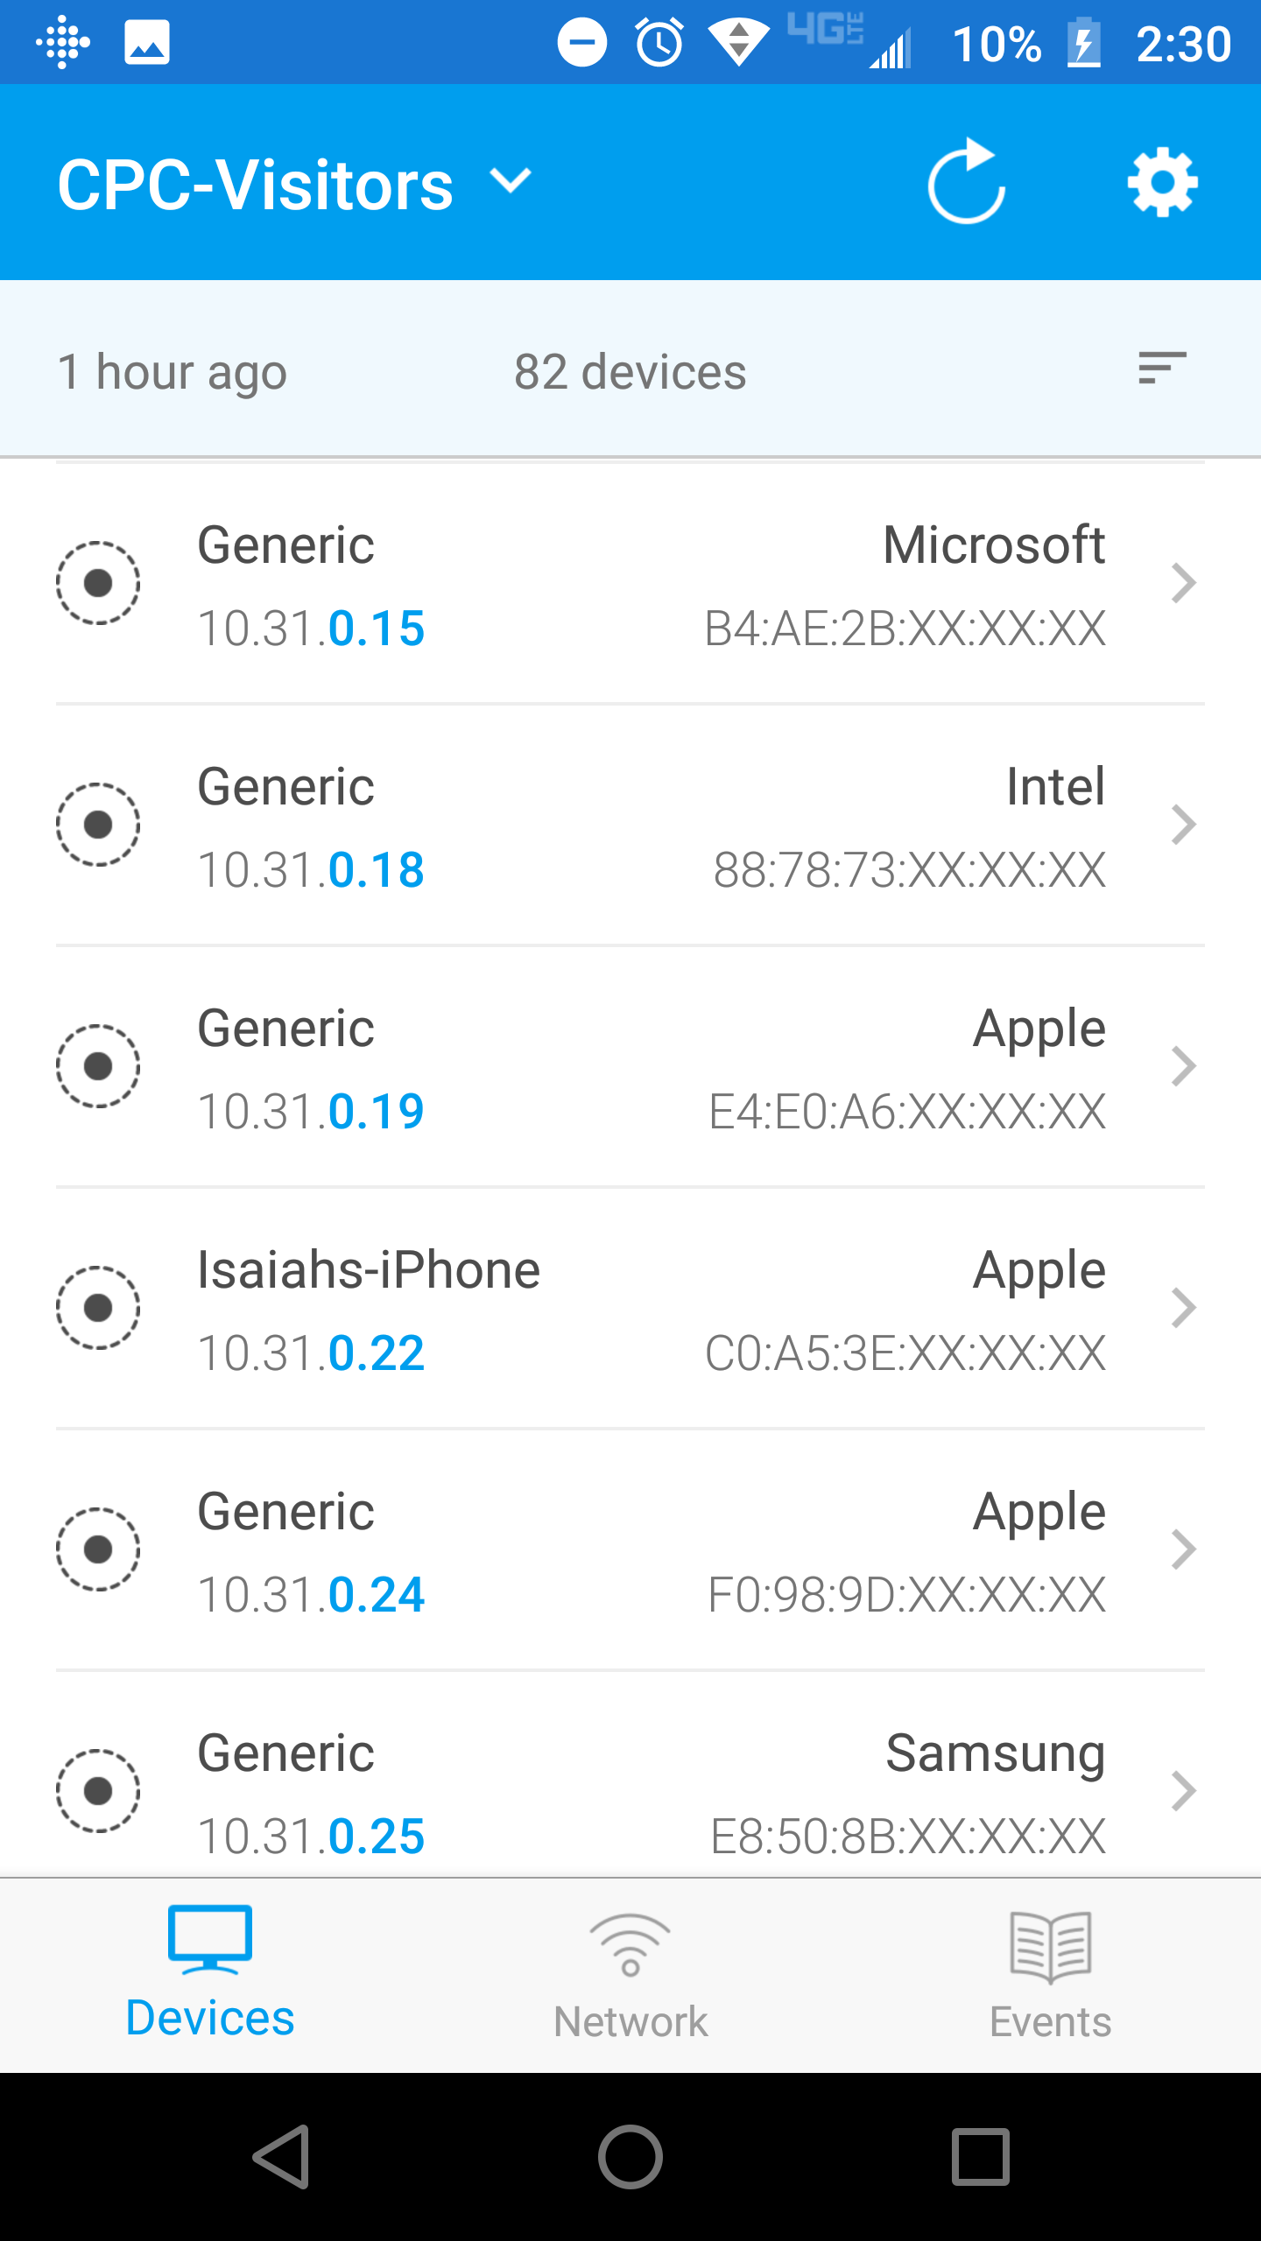
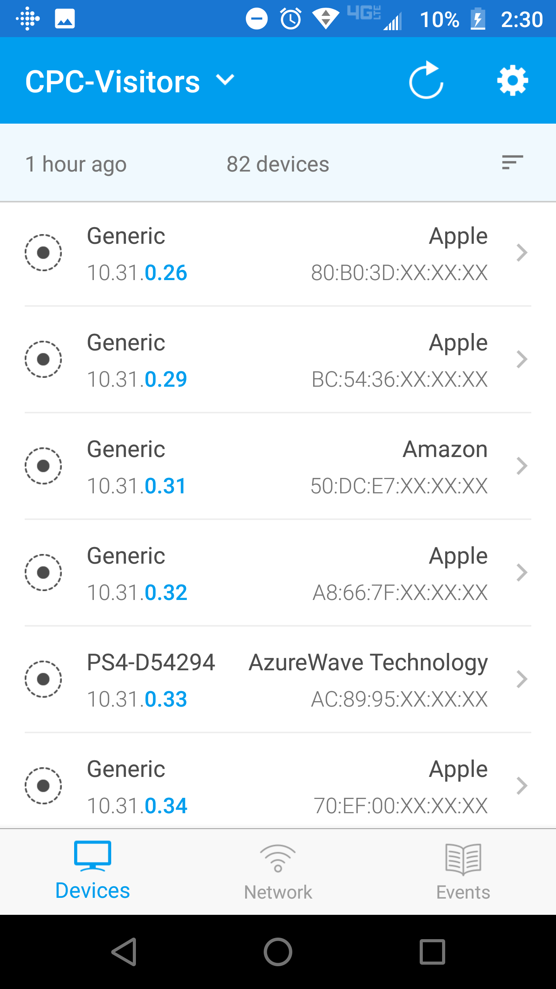
Scanning with Fing

Slide 21
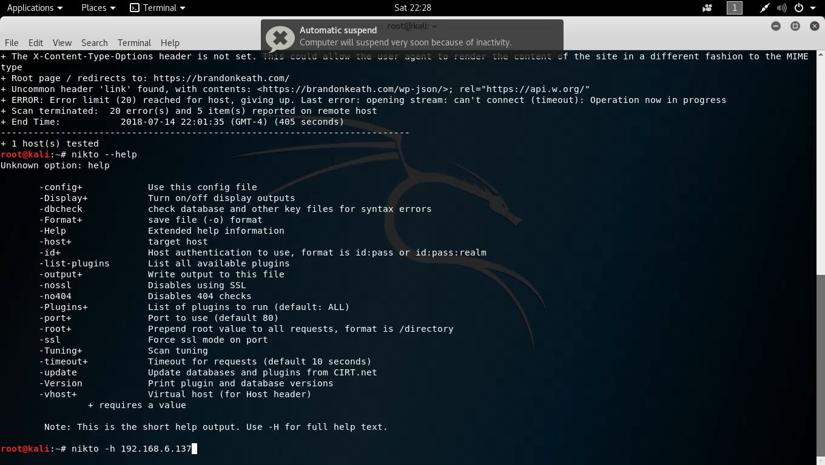
Scanning Demo Nikto

Slide 22
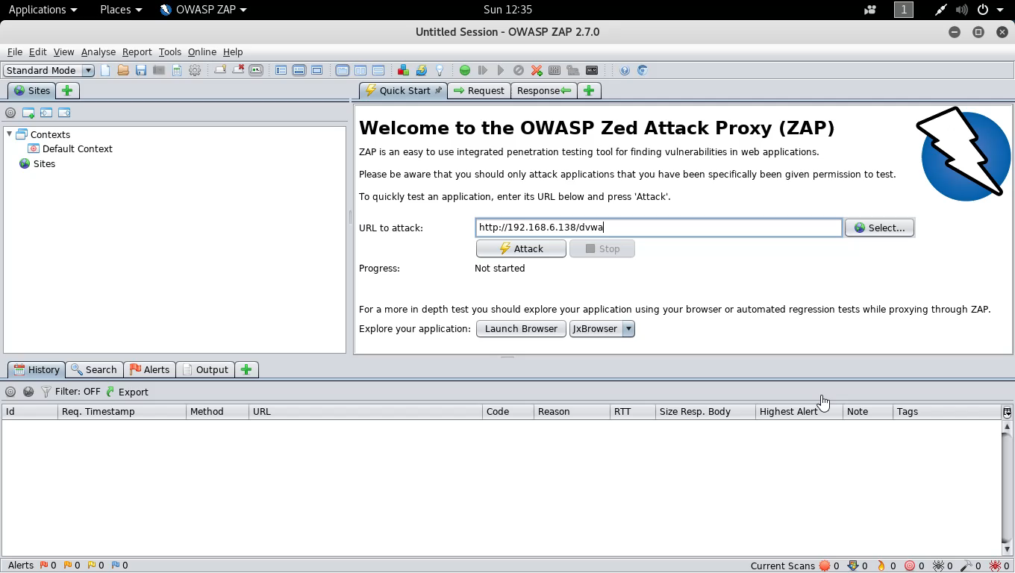
Scan Demo 2

Slide 23

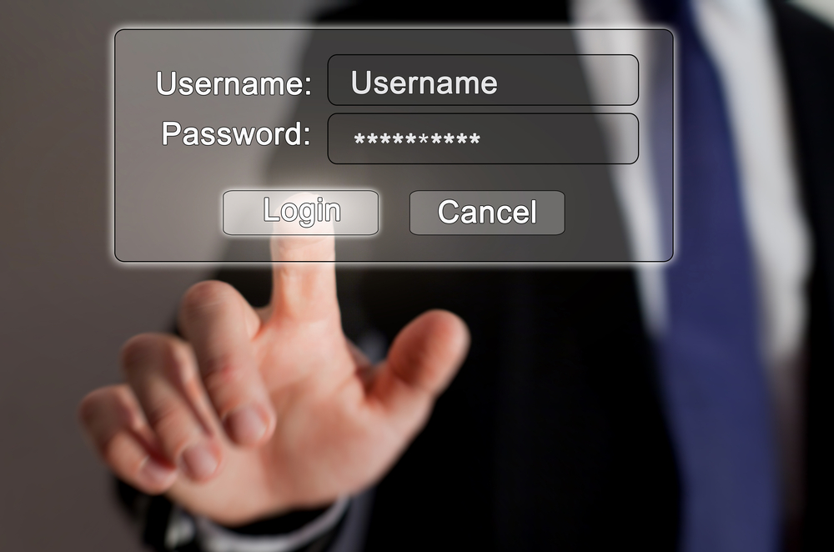
Gaining Access

Slide 24
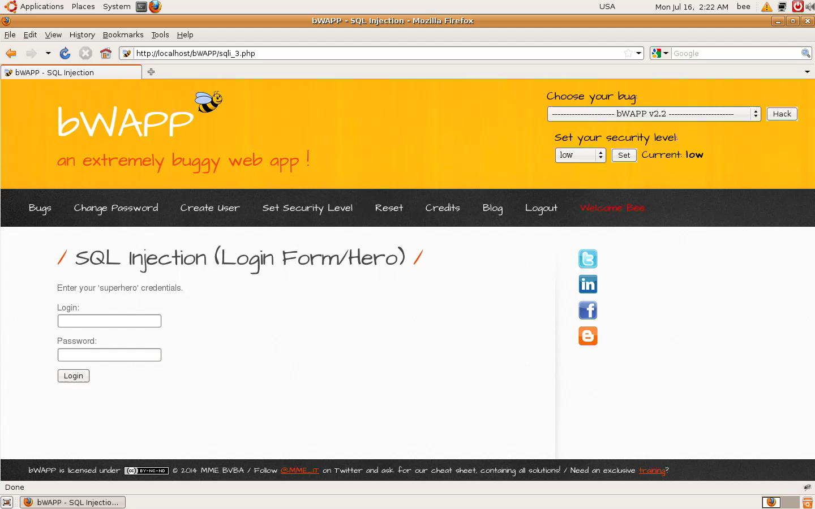
Gaining Access with SQL Injection

Slide 25
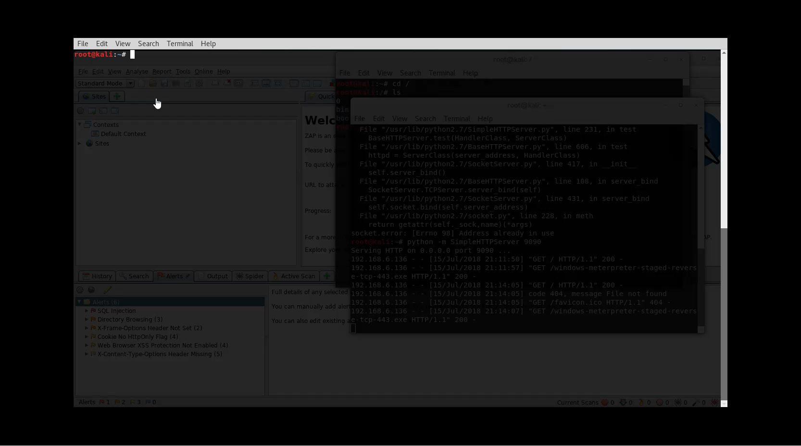
Gaining Access with .EXE File

Slide 26
Maintaining Access
Install additional malware/backdoors
Compromise Other Systems
Begin to download sensitive information

Slide 27
Covering Tracks
Delete or Modify log files
Remove all traces of malware on system
Decommission system or malware used for hack.

Slide 28

Web Hacking

Slide 29
What is Vulnerability/Pen Testing?
Web Vulnerability Scanning:
Is a process for identifying potential web application
vulnerabilities within web application code.
Web Penetration Testing
Is a process for verifying potential vulnerabilities using actual exploits and tests to determine if the vulnerability is a false positive.

Slide 30
Where do I start and what really is a secure web application?
OWASP provides a free Web Application security testing framework providing a foundation for testing: OWASP Testing Guide 4.0
OWASP Provides a detailed definition of what a “secure” web application is in their Application Security Verification Standard (ASVSP)
BWAPP provides an insecure web application that you can practice web hacking on.

Slide 31
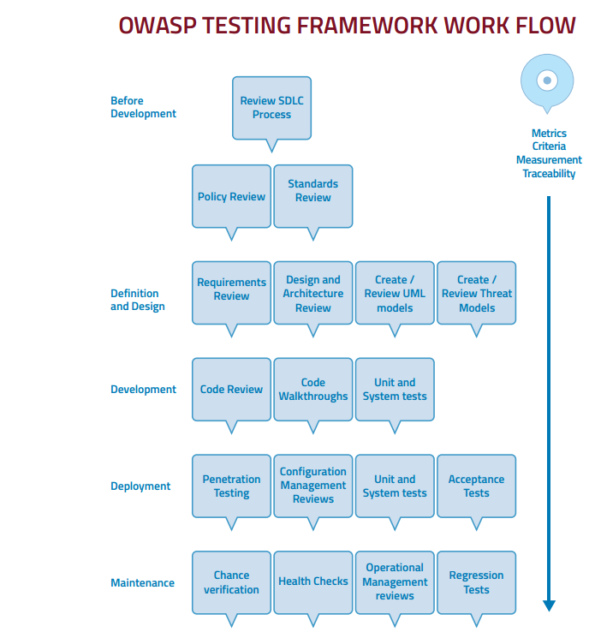
SDLC Test Framework

Slide 32
What do we test for?
OWASP releases a Top 10 that details information OWASP Top 10
OWASP TOP 10
A1 Injection | A2 Broken Authentication
A3 Sensitive Data Exposure | A4 XML External Entities
A5 Broken Access Control | A6 Security Misconfiguration
A7 Cross Site Scripting | A8 Insecure Deserialization
A9 Using Known Vulnerable Components | A10 Insufficient Logging & Monitoring

Slide 33
Security Tools
Kali Linux - https://www.kali.org/downloads/
Metasploit - https://www.offensive-security.com/metasploit-unleashed/
OWASP ZAP - https://github.com/zaproxy/zaproxy/wiki/Downloads
Burp Suite - https://portswigger.net/burp

Slide 34
BWAPP and Webgoat Security Training
WebGoat is an open source security training tool.
BWAPP is another tool that can be used for application security training.
HackSplaining is a great resource for learning about web exploits:

Slide 35
OWASP ZAP
OWASP ZAP is an easy to use integrated pen testing tool for finding vulnerabilities in web applications.
Zap provides automated scanners and a set of tools for manually finding vulnerabilities.
Zap is a great tool for most open source security testing needs.

Slide 36
Burp Suite
Burp Suite is a commercial tool that includes the following:
Automated crawl and scan of 100 vulnerabilities
Intercept browser traffic as a man in the middle proxy
Automate custom attacks using Burp Intruder
Extensible with Python and Java Programming plugins
Burp is considered the standard for web penetration testing and costs $350 for a commercial license.

Slide 37
Websites for Learning Hacking
https://www.hackthissite.org/
https://www.vulnhub.com/
https://www.offensive-security.com/metasploit-unleashed/
https://null-byte.wonderhowto.com/

Slide 38
Bug Bounty Hunting?
Application Security Testing in Production!
Bug bounty hunters earn between $10,000-$500,000/year as hunters
www.hackerone.com
www.bugcrowd.com
https://www.hacker101.com/

Slide 39
Resources for Getting Started in Cyber Security
Meetups and Events like this one!
https://Cybrary.IT
https://ElearnSecurity.com
Learn Python from Microsoft:
https://mva.microsoft.com/en-us/training-courses/introduction-to-programming-with-python-8360

Slide 40

Open Questions and Answers
Visit my terrible blog at www.brandonkeath.com for security updates.
Check out http://pahackers.com to stay up to date for new ethical hacking meet ups and events in the local area.
Sign up for the free Pen Testing Student
Class offered by ElearnSecurity by singing up for
The Ethical Hacker Network
https://www.ethicalhacker.net/register/

